Slide 1
Remax Clone
An app for viewing properties, communicating with realtors,
reading and commenting on a realtor-managed blog.
by
Dang Huynh Minh (#1670214)
Anastassia Tarassova (#1277712)
Trang Trieu (#6341464)

Slide 2

Background
Remax clone is a real estate website.
Numerous challenging aspects
Opportunity to reuse the Google Maps API idea from past course
Will look great in a portfolio

Slide 3

Solution overview
Home page

Slide 4
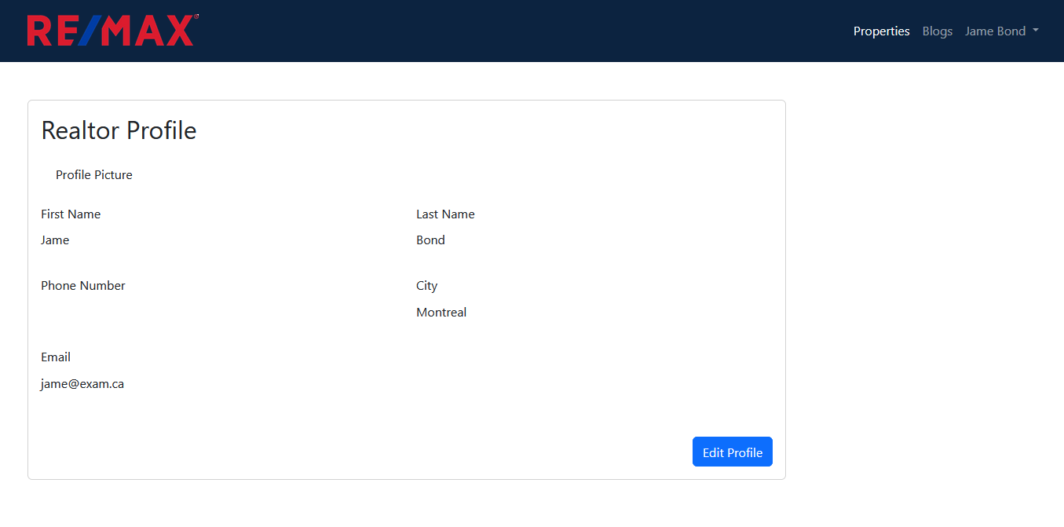
Solution overview
User profile

Slide 5
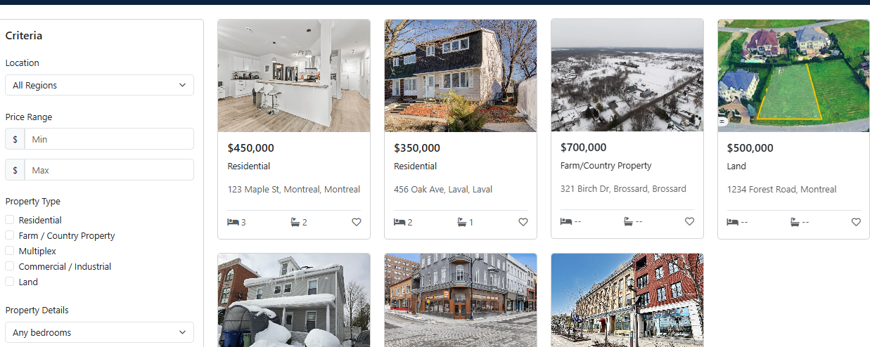
Solution overview
Search

Slide 6

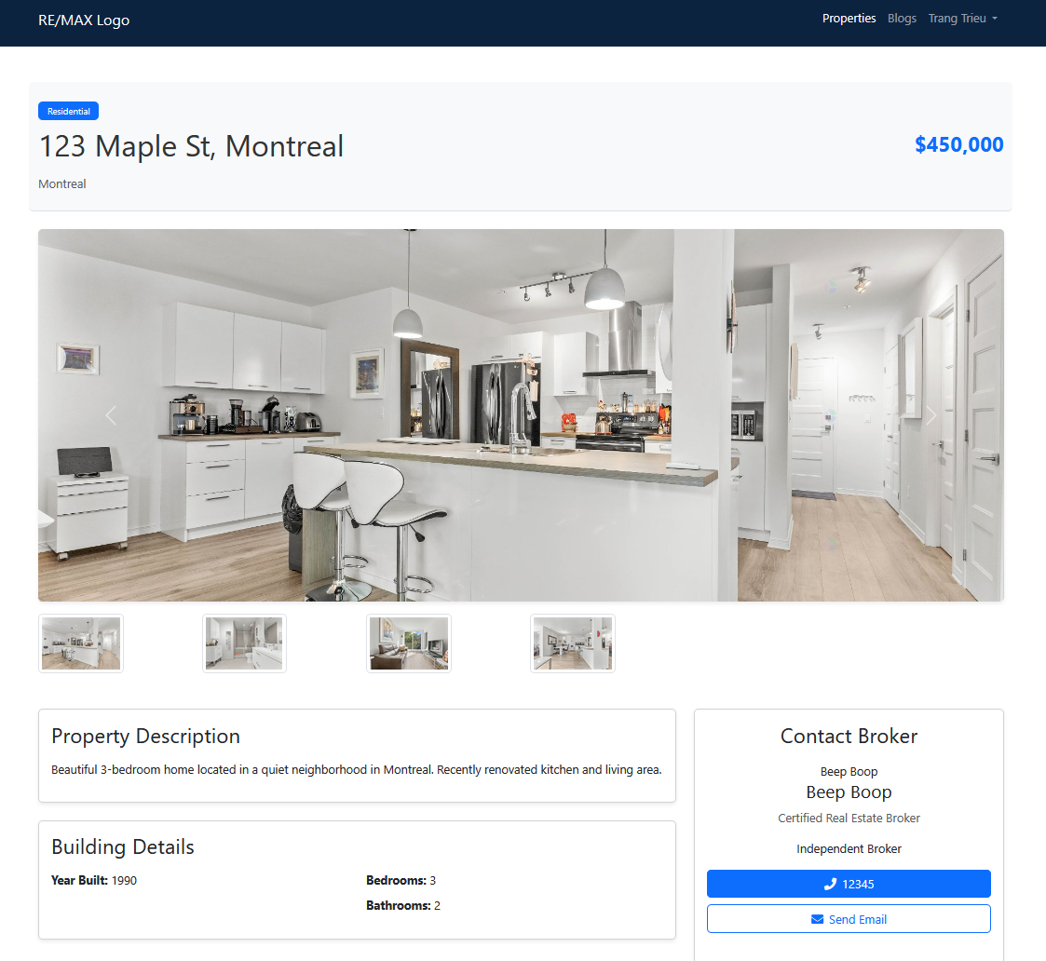




Solution overview

Slide 7
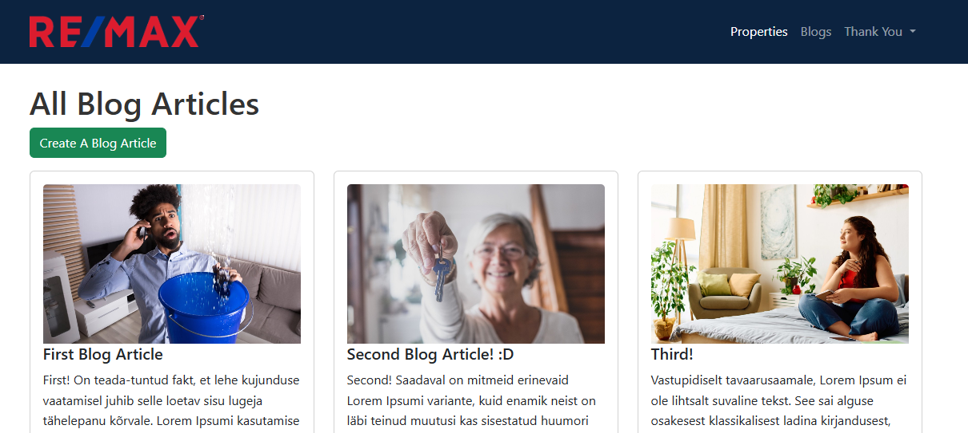
Solution overview
Blogs

Slide 8
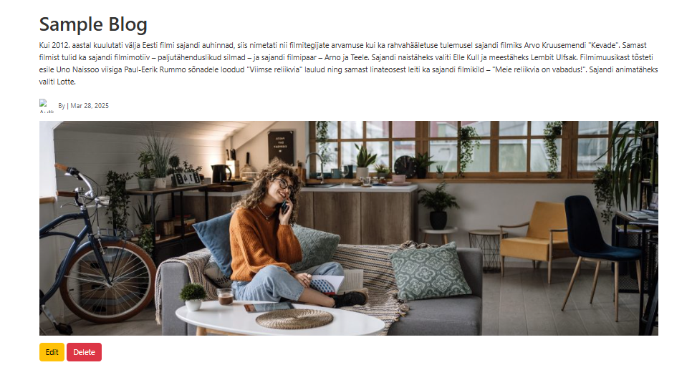
Solution overview
Blog as seen by author (realtor)

Slide 9
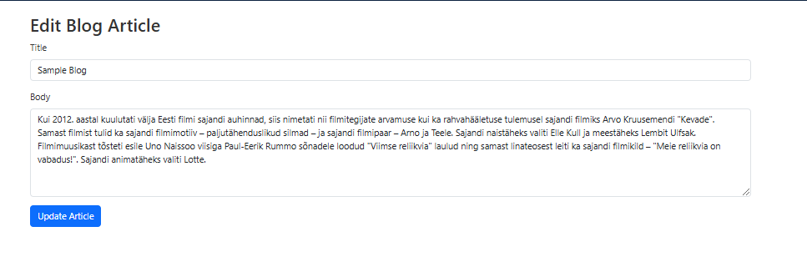
Solution overview
Editing a blog as seen by author

Slide 10
Roles
Dang: profiles
Ana: routes, models, blog, comments
Trang: user login/registration , DB schema, properties
Everyone: front-end, testing
Notes:
add a slide of who did what. It’s okay to list things twice if it was teamwork.

Slide 11
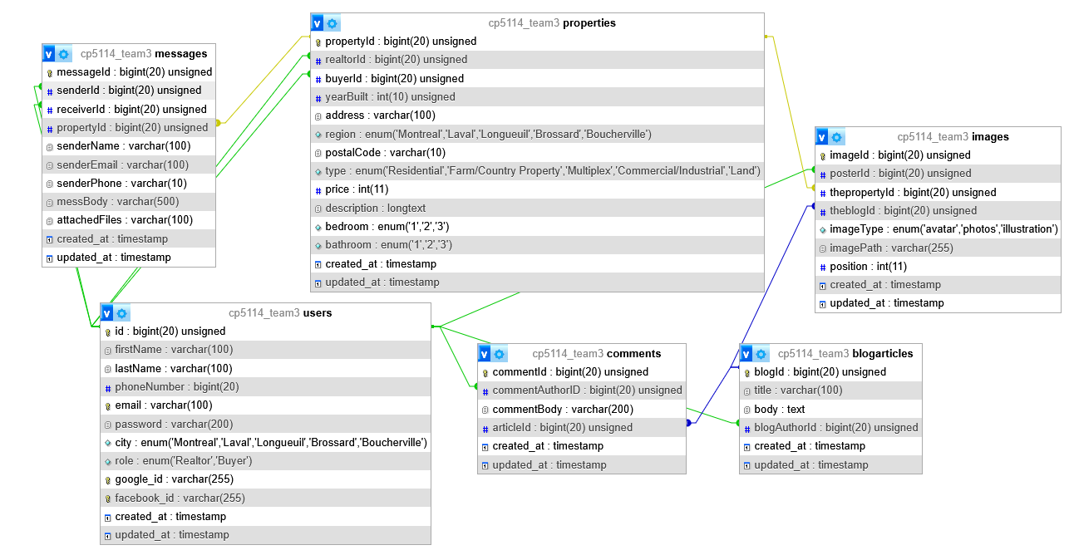
Database structure

Slide 12




Challenges and Solutions

Slide 13

Challenges
Technology:
Familiarize Laravel framework
Switch to Herd from Xamp Mamp Wamp
MeekroDB conflicted with Eloquent ORM
Project
Property Search and Filtering
Security and Data Protection

Slide 14
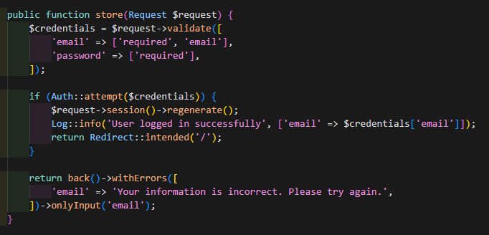
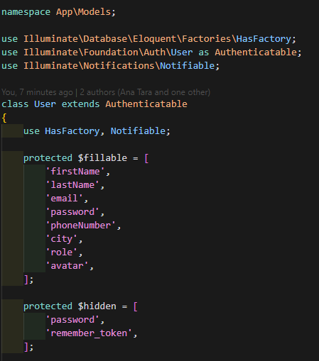
What we learned (Trang)
Login Auth in Laravel
Login Controller
User model

Slide 15
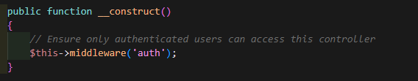
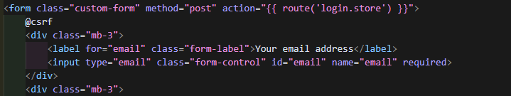
What we learned
Profile Controller
Login View
(login.blade.php)

Slide 16

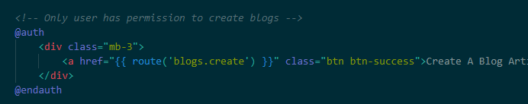
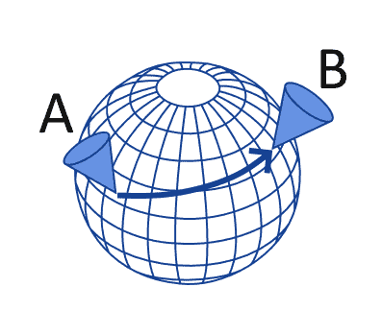
What we learned (Ana)
E
@guest and @auth
Haversine formula

Slide 17
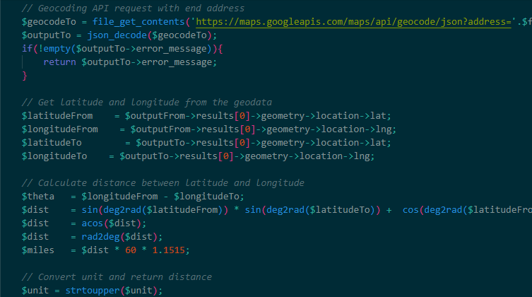
Haversine formula

Slide 18
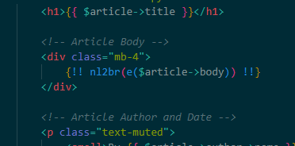
What we learned (Ana)
Escape any potentially harmful HTML/JS using e()
<script>alert('XSS')</script> becomes &lt;script&gt;alert('XSS')&lt;/script&gt;
Convert newline characters in the article body to actual HTML line breaks using nl2br().
two lines become line1<br>line2
Render this safe HTML back into the page using {!! !!}
Used only for safe HTML

Slide 19
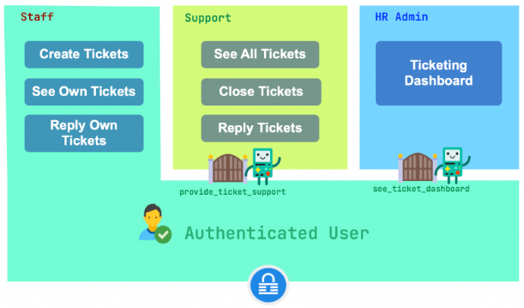
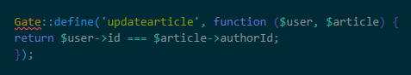
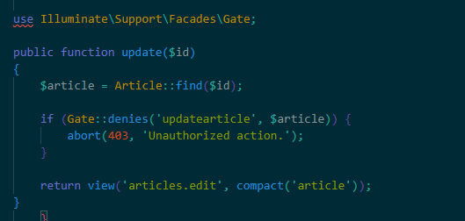
What we learned (Ana)
Laravel Gates
Defined in AuthServiceProvider
Can be associated with façades

Slide 20
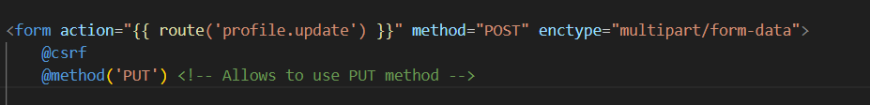
What we learned (Dang)
@csrf
Put method in form

Slide 21
Future work
Finalize internal messaging system
Finalize Google Maps Geolocalisation API
Walking distance from amenities (schools, hospitals, shopping centers, parks, etc.)
Comments should be moderated via Edit and Delete
Autosuggestions based on past searches
Arrays of liked properties by users

Slide 22
Summary
We built a Remax clone website for realtors and potential buyers.
Users can register, login and view their profile.
Users can search and view listed properties.
Users can read blog articles and comments.
Registered users can comment on blog posts.
Realtors can CRUD properties and blog posts.
Some features are missing/not completed.
Each feature functions while being loosely connected to each other.

Slide 23

Thank you for listening

